Slide 1
CAP442 Web Technology
Unit II
Session 2
II Year M.C.A

Slide 2
Contents
Reading values from text box
Function call on button click event
Simple form validations

Slide 3
Document Object
When an HTML document is loaded into a web browser, it becomes a document object.
The document object is the root node of the HTML document.
Properties and Methods
Some of the properties and methods HTML document objects are listed here.

Slide 4
Property / Method Description
activeElement Returns the currently focused element in the document
addEventListener() Attaches an event handler to the document
anchors Returns a collection of all <a> elements in the document that have a name attribute
baseURI Returns the absolute base URI of a document
close() Closes the output stream previously opened with document.open()
cookie Returns all name/value pairs of cookies in the document

Slide 5
Property / Method Description
createElement() Creates an Element node
createEvent() Creates a new event
createTextNode() Creates a Text node
execCommand() Invokes the specified clipboard operation on the element currently having focus.
forms Returns a collection of all <form> elements in the document
fullscreenElement Returns the current element that is displayed in fullscreen mode
fullscreenEnabled() Returns a Boolean value indicating whether the document is enabled for full screen mode

Slide 6
Property / Method Description
defaultView Returns the window object associated with a document, or null if none is available.
doctype Returns the Document Type Declaration associated with the document
documentURI Sets or returns the location of the document
domain Returns the domain name of the server that loaded the document

Slide 7
images Returns a collection of all <img> elements in the document
lastModified Returns the date and time the document was last modified
links Returns a collection of all <a> and <area> elements in the document that have a href attribute
open() Opens an HTML output stream to collect output from document.write()
querySelector() Returns the first element that matches a specified CSS selector(s) in the document
querySelectorAll() Returns a static NodeList containing all elements that matches a specified CSS selector(s) in the document

Slide 8
readyState Returns the (loading) status of the document
referrer Returns the URL of the document that loaded the current document
removeEventListener() Removes an event handler from the document (that has been attached with the addEventListener() method)
renameNode() Renames the specified node
URL Returns the full URL of the HTML document
write() Writes HTML expressions or JavaScript code to a document
writeln() Same as write(), but adds a newline character after each statement

Slide 9
Property / Method Description
getElementById() Returns the element that has the ID attribute with the specified value
getElementsByClassName() Returns a HTMLCollection containing all elements with the specified class name
getElementsByName() eturns a HTMLCollection containing all elements with a specified name
getElementsByTagName() Returns a HTMLCollection containing all elements with the specified tag name
hasFocus() Returns a Boolean value indicating whether the document has focus

Slide 10
Accessing Content of Text box
Among all the methods the method, getElementById() Method is very important and often used method
The getElementById() method returns the element that has the ID attribute with the specified value.
This method is one of the most common methods in the HTML DOM, and is used almost every time you want to manipulate, or get info from, an element on your document.
Returns null if no elements with the specified ID exists.
An ID should be unique within a page. However, if more than one element with the specified ID exists, the getElementById() method returns the first element in the source code.

Slide 11
Syntax
document.getElementById(elementID)
Example
Get the element with id="demo" and change its color:
var x = document.getElementById("demo"); // Get the element with id="demo" x.style.color = "red"; // Change the color of the element

Slide 12
innerHTML Property
The innerHTML property sets or returns the HTML content (inner HTML) of an element.
Syntax
HTMLElementObject.innerHTML - Returns the innerHTML property
HTMLElementObject.innerHTML = text - Sets the innerHTML property
Example
Get the HTML content of a <p> element with id="myP":
var x = document.getElementById("myP").innerHTML;

Slide 13
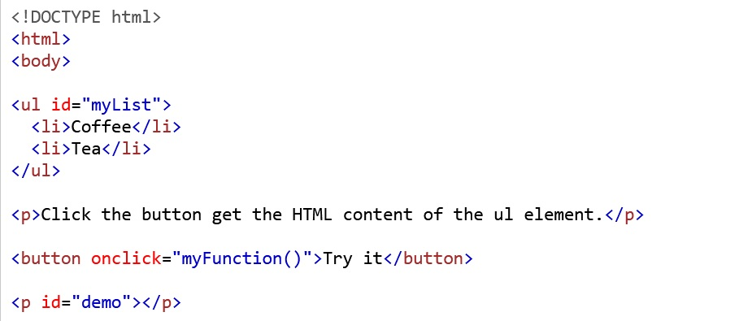
Get the HTML content of a <ul> element with id="myList":

Slide 14
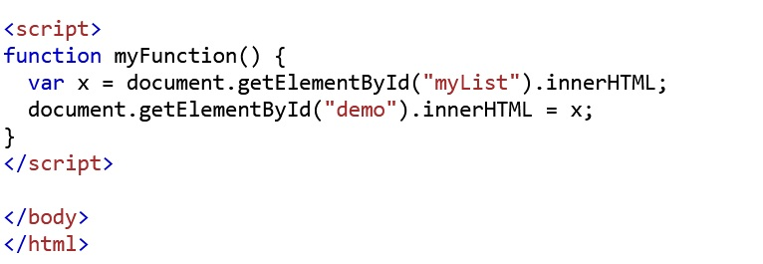

Slide 15
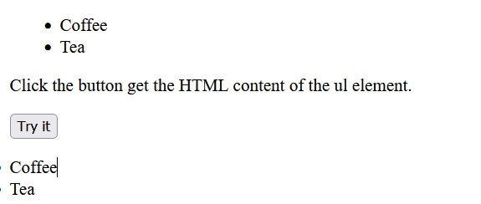
Output:

Slide 16
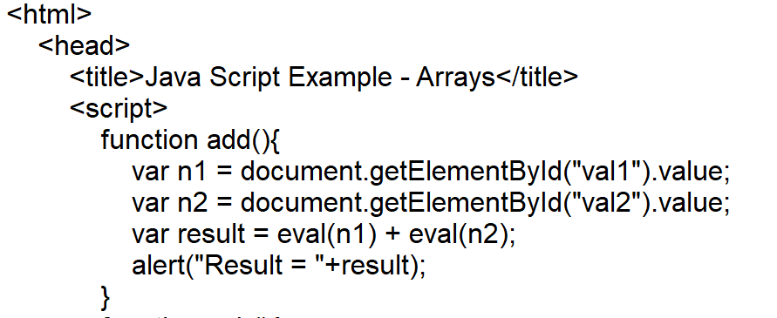
Java script to perform addition and subtraction

Slide 17
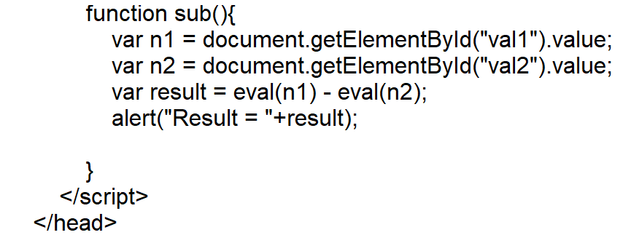

Slide 18
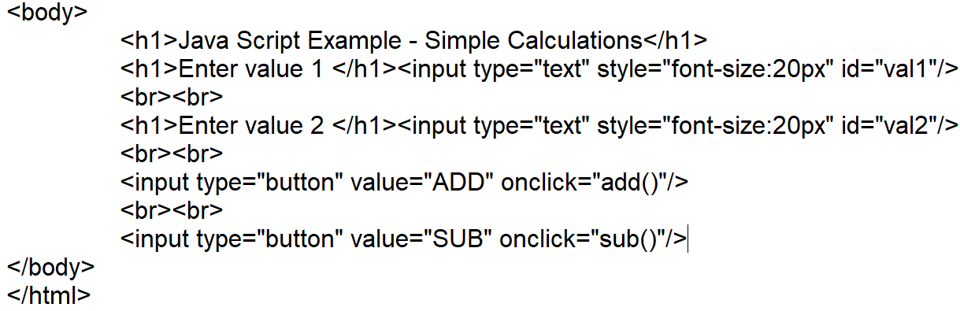

Slide 19
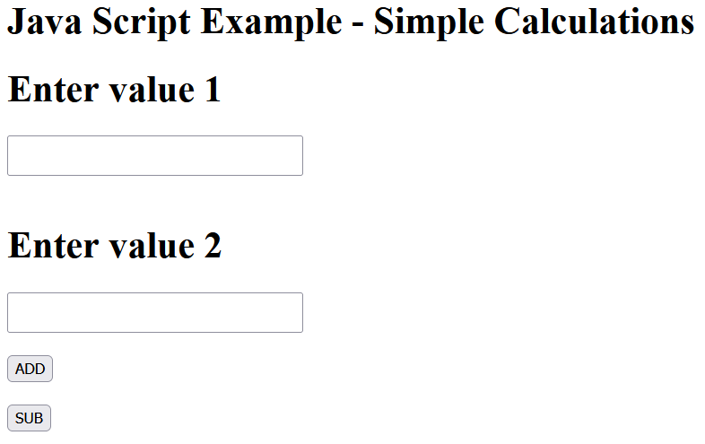
Output

Slide 20
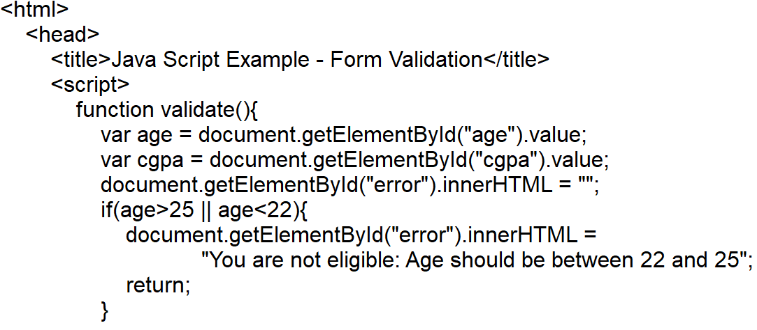
Simple form validation
Java script to perform simple form validation – Checking CGPA value is valid input or not

Slide 21
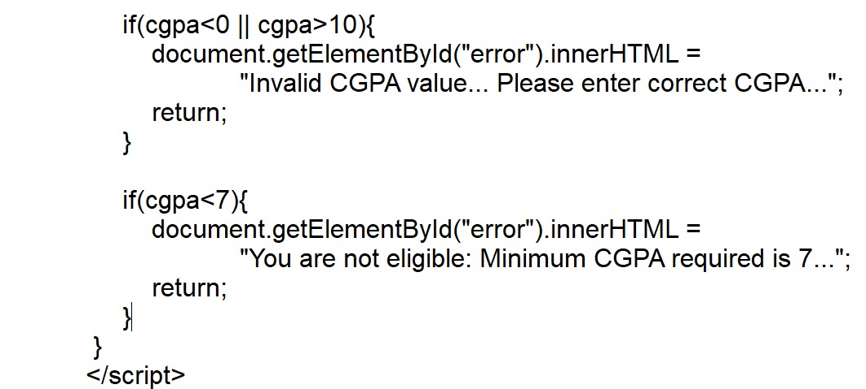

Slide 22
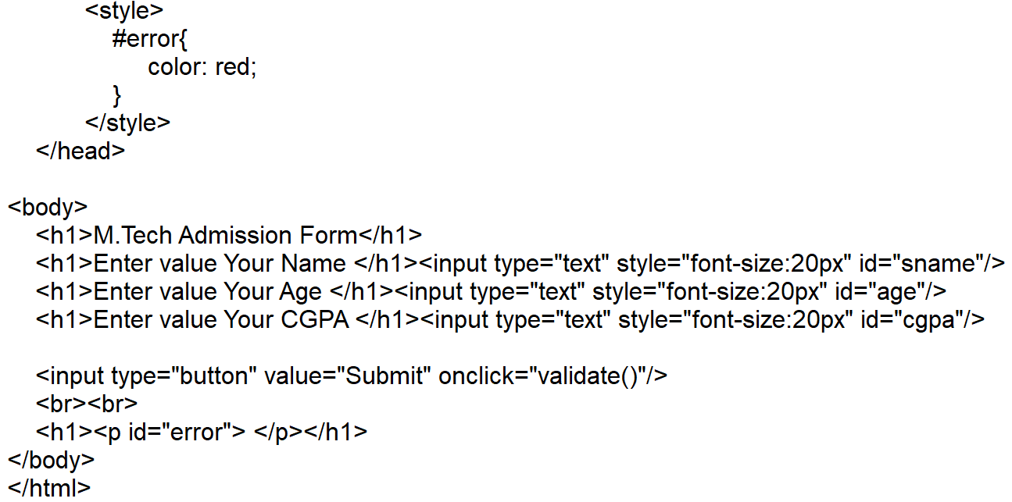

Slide 23
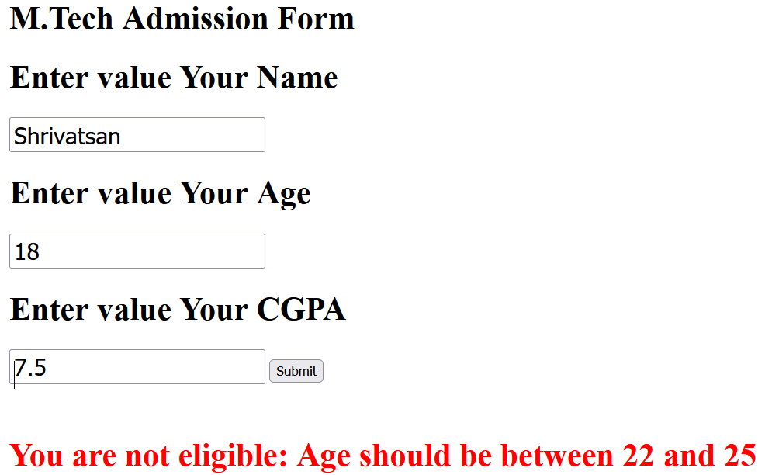
Output

Slide 24
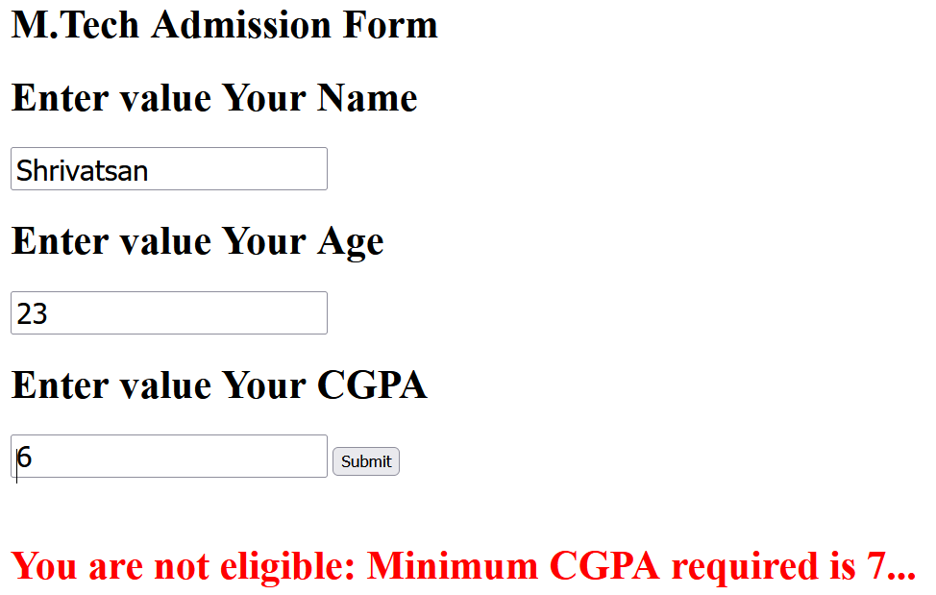
Output

Slide 25
References
https://www.w3schools.com/js/default.asp

